Slide 1
5 Basic Design Patterns
V2.0
Noviembre 2011
Ferreiras

Slide 2
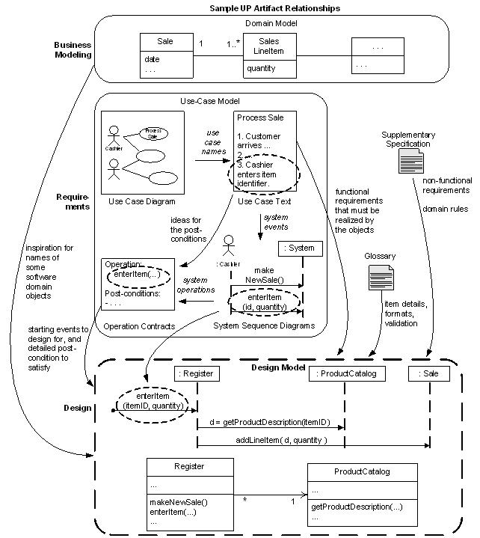
The Roadmap


Slide 3
Controller pattern
A Controller is a non–user interface object responsible for receiving or handling a system event. It defines methods for system operation.

Slide 4
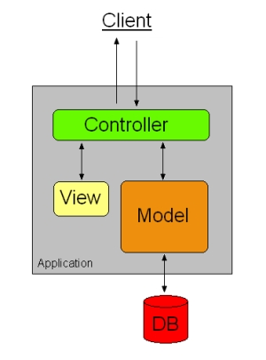
Controller pattern
The controller receives user input and initiates a response by making calls on model objects. A controller accepts input from the user and instructs the model and a view port to perform actions based on that input.
The Front Controller pattern defines a single component that is responsible for processing application requests. A front controller centralizes functions such as view selection, security, and templating, and applies them consistently across all pages or views. Consequently, when the behavior of these functions need to change, only a small part of the application needs to be changed: the controller and its helper classes.

Slide 5
Controller pattern
Who should be responsible for handling an input system event?
  ➢ Assign the responsibility for receiving or handling a system event message to a class representing one of the following choices:
    → Represent the overall system, device, or subsystem;
    → Represents a use case scenario within which the system event occurs

Slide 6
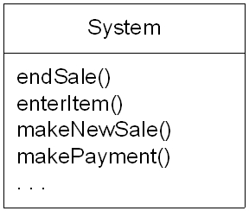
Controller pattern
For example, in a point of sale (POS)
Considers the System Operations 
Who should be controller for system events such as enterItem and endSale?
➔

Slide 7
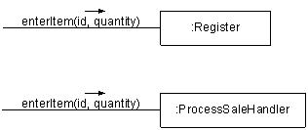
Possible Controllers

Slide 8
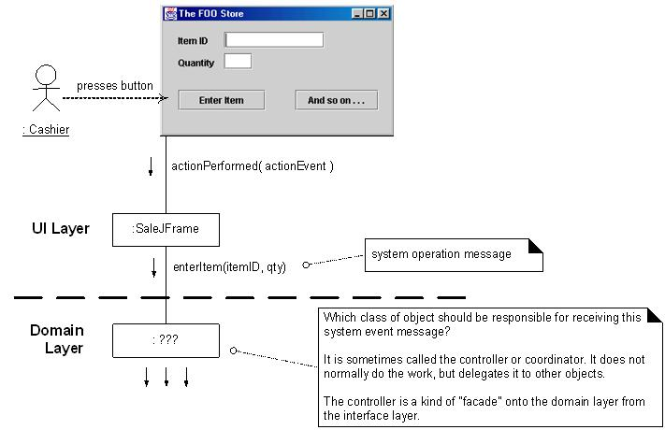
Controller for enterItem?

Slide 9
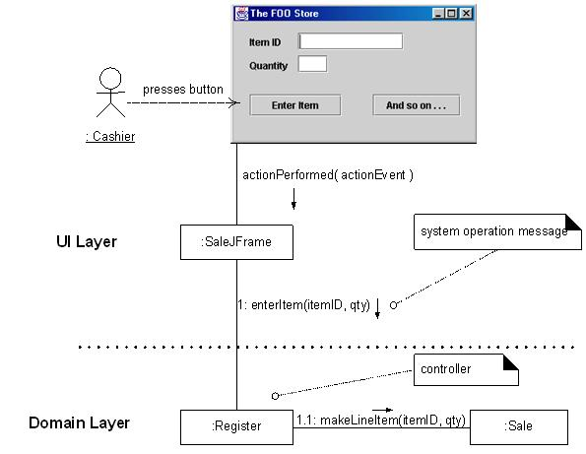
Desirable Coupling of interface layer to domain layer

Slide 10
Creator Pattern
The Creator pattern helps answer the question of which object should be responsible for creating new objects (instances of some class). There are several cases to consider.

Slide 11
Creator Pattern
➢ The creation of objects is one of the most common activities in an object-oriented system.
➢ Consequently, it is useful to have a general principle for assignment of creation responsibilities.

Slide 12
Creator Pattern
Let A and B be objects.
Assign class B the responsibility to create an instance of class A if one or more of the following is true :
→ B aggregates A objects .
→ B contains A objects.
→ B records instances of A objects.
→ B closely uses A objects.
→ B has the initializing data that will be passed to A when it is created
→ B is a creator of A objects.

Slide 13
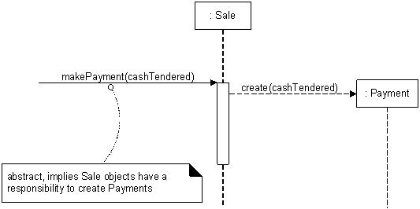
 Example:

Slide 14
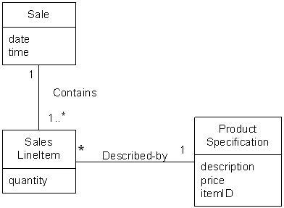
Creator Pattern
For example, the POS, Who should be responsible for creating a SalesLineItem instance?
Partial Sale Domain Model

Slide 15
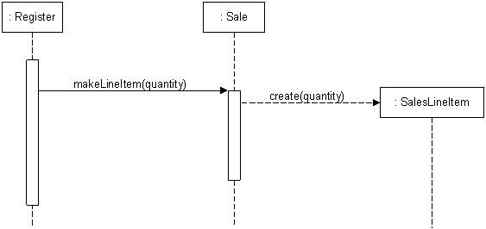
Creator Pattern
Creating a SalesLineItem

Slide 16
Expert Pattern
Since all processes work with data, it makes sense to use the location of data as a basis for assigning behavior. The expert pattern states that a responsibility should be assigned to an object which itself contains most of the data required to carry out the responsibility or which can communicate with other objects having the data. The reason is that an operation should not have to search extensively for its essential data.

Slide 17
Expert Pattern
It is the most basic principle for assigning responsibilities to objects: Assign a responsibility to the class that has the information needed to fulfill it.
By assigning behavior to classes on the basis of where the data is located, the design is improved and the program is simpler to understand.

Slide 18
Expert Pattern
An information expert Is a class that has the information necessary to fulfill the responsibility.

Slide 19
Expert Pattern
During design, we make choices about the assignment of responsibilities to classes. Information Expert helps us decide, once we know the task (responsibility), which class to make responsible for carrying out the task.

Slide 20
Expert Pattern
Information Expert says: Assign a responsibility to the information expert; the class that has the information necessary to fulfill the responsibility.

Slide 21
Expert Pattern
For Example, the POS, Who should be responsible for knowing the grand total of a sale?
By Information expert, we should look for the class of objects that has the information needed to determine the total. Where to look? 
   Design model
   Domain model

Slide 22
Expert Pattern
Partial Sale Domain Example

Slide 23
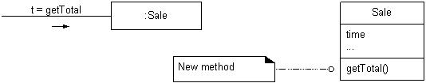
Expert Pattern
 Partial interaction and class diagrams

Slide 24
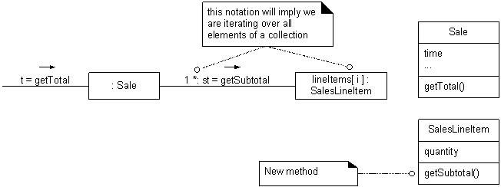
Expert Pattern
 Calculating the Sale total

Slide 25
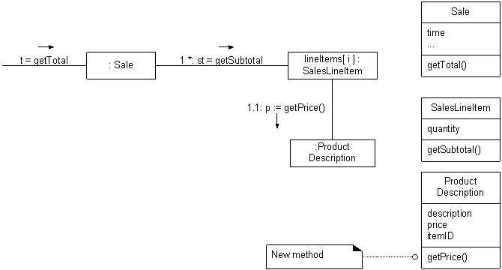
Expert Pattern
 Calculating the Sale Total (refined)

Slide 26
Singleton Pattern
Is a design pattern used to restrict the instantiation of a class to one object. This is useful when exactly one object is needed to coordinate actions across the system. Provides a single place to obtain visibility to another part of the system.

Slide 27
Singleton Pattern
Provide a single access point by defining a class which refers to only one instance (the “singleton”) which provides global visibility to the other objects in the system.;

Slide 28
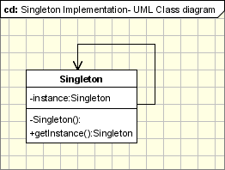
Singleton Pattern
The implementation involves a static member in the "Singleton" class, a private constructor and a static public method that returns a reference to the static member.

Slide 29
Singleton Pattern
The Singleton Pattern defines a getInstance operation which exposes the unique instance which is accessed by the clients. getInstance() is is responsible for creating its class unique instance in case it is not created yet and to return that instance.

Slide 30
Singleton Pattern
class Singleton {
private static Singleton instance;
private Singleton() {
...
}
public static synchronized Singleton getInstance() {
if (instance == null)
instance = new Singleton();
return instance;
}
...
public void doSomething(){
...
}
}

Slide 31
Singleton Pattern
in the code, getInstance() method ensures that only one instance of the class is created. The constructor should not be accessible from the outside of the class to ensure the only way of instantiating the class would be only through the getInstance() method.
The getInstance() method is used also to provide a global point of access to the object and it can be used in the following manner:
Singleton.getInstance().doSomething();

Slide 32
Singleton Pattern
The singleton pattern is implemented by creating a class with a method that creates a new instance of the class if one does not exist. If an instance already exists, it simply returns a reference to that object. To make sure that the object cannot be instantiated any other way, the constructor is made private.

Slide 33
Singleton Pattern¹
The Singleton Design Pattern allows you to have only a single instance of an object of a particular class anywhere in the application. The pattern will work in any class library or web services in the same application domain. For example, if you have webService1 and webService2 and they are both in the same running application domain, you will see that both web services are accessing the same object instance.
1) http://www.devlake.com/design-patterns/singleton

Slide 34
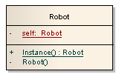
Singleton Pattern¹
Let's see an example. In the example we will have an object instance of the Robot class, and anywhere in the application it should only have one single instance of the Robot object.
Below is the UML of the Robot singleton:
1) http://www.devlake.com/design-patterns/singleton

Slide 35
Singleton Pattern¹
Below is the code of the Robot singleton:
public class Robot
{
private static Robot self;
//hide the default constructor
private Robot() { }
public static Robot Instance()
{
//create instance only if we don't have one
if (self == null)
self = new Robot();
return self;
}
}
1) http://www.devlake.com/design-patterns/singleton

Slide 36
Singleton Pattern¹
The client code(calling code) to access the singleton will be:
Robot b = Robot.Instance();
Notice that:
■ We hide the default constructor so that the entire application can only call public static Instance method to access the singleton.
■ The private static self variable holds the actual single instance of the class.
1) http://www.devlake.com/design-patterns/singleton

Slide 37
Singleton Pattern¹
Below are the implementation code and the output of the singleton pattern using our example. Notice that every Robot instance in the application is the same object instance:
class Program
{
static void Main(string[] args)
{
Robot a = Robot.Instance();
a.Name = "Jim";
Robot b = Robot.Instance();
Console.WriteLine("Robot's name is: " + b.Name);
Robot c = Robot.Instance();
Console.WriteLine("Robot's name is: " + c.Name);
}
}
1) http://www.devlake.com/design-patterns/singleton

Slide 38
Singleton Pattern¹
public class Robot {
private static Robot self;
private string name;
public string Name {
get { return name; }
set { name = value; }
}
//hide the default constructor
private Robot() { }
public static Robot Instance() {
//create instance only if we don't have one
if (self == null)
self = new Robot();
return self;
}
}
1) http://www.devlake.com/design-patterns/singleton

Slide 39
Facade¹
The façade design pattern allows you to provide a simplified interface from multiple class libraries. It provides a simple interface that hides the complexity of the class libraries being used.
1) From http://www.devlake.com/design-patterns/facade

Slide 40
Facade
Is an object that provides a simplified interface to a larger body of code, such as a class library. The name is by analogy to an architectural facade.

Slide 41
Facade
For example, if the client code needs to access 3 different class libraries for a single functionality, instead of having the client code accessing those 3 class libraries, you can just create another class that calls the 3 class libraries and have the client access only the class that you have created. The result is a simplified interface for the client and the client will not need to know the details of the different class libraries.

Slide 42
Facade
Below shows an example of the façade pattern in UML that shows the client code accessing only the new class, the Facade, that you have created ( See next slide ):

Slide 43
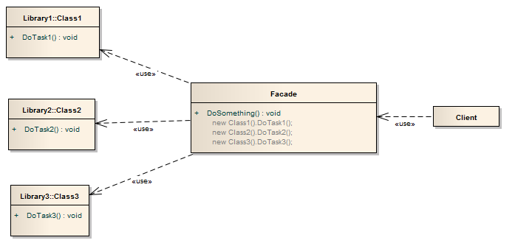
Facade
..

Slide 44
Facade
Following are shown the implementation code and the output of the facade pattern, notice the client code only need to access the Facade class to gain the functionalities of the 3 class libraries:

Slide 45
Facade
namespace Façade {
class Program {
static void Main(string[] args) {
Facade f = new Facade();
f.DoSomething();
}
}
class Façade {
public void DoSomething() {
Library1.Class1 a = new Library1.Class1();
Library2.Class2 b = new Library2.Class2();
Library3.Class3 c = new Library3.Class3();
a.DoTask1();
b.DoTask2();
c.DoTask3();
}
}
}

Slide 46
Facade
namespace Library1 {
public class Class1 {
public void DoTask1() {
Console.WriteLine("Doing task 1");
}
}
}
namespace Library2 {
public class Class2 {
public void DoTask2() {
Console.WriteLine("Doing task 2");
}
}
}
namespace Library3 {
public class Class3 {
public void DoTask3() {
Console.WriteLine("Doing task 3");
}
}
}

Slide 47
References
 "Object-Oriented Software Engineering: Using UML, Patterns, and Java", 2nd Ed. by Bernd Bruegge and Allen H. Dutoit, Prentice Hall, 2004.
 "Applying UML and Patterns: An Introduction to Object-Oriented Analysis and Design and the Unified Process," 2nd Ed., by Craig Larman, Pretice Hall, 2002.
 Object-Oriented Systems Analysis and Design With UML, Robert V. Stumpf, Lavette C. Teague, Pearson, 2004
 http://www.devlake.com/
 Wikipedia

